Slide 1
Computer Networks _22CS008
SNMP
Lecture 60
Prepared by
Dr. Mankirat Kaur
Department of Computer Science and Engineering,
Chitkara University, Punjab

Slide 2
Index
SNMP
Network Management
Simple Network Management Protocol
Components of network management on the Internet
SMI
MIB
SNMP PDU’s

Slide 3
NETWORK MANAGEMENT SYSTEM
We can say that the functions performed by a network management system can be divided into five broad categories:
Configuration Management
Fault Management
Performance Management
Security Management
Accounting Management

Slide 4
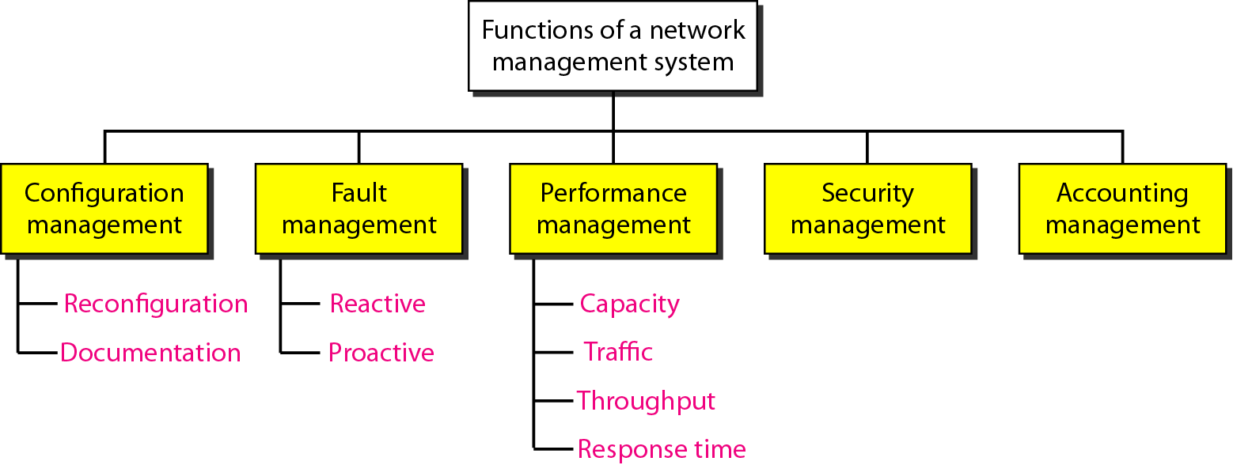
NETWORK MANAGEMENT SYSTEM
We can say that the functions performed by a network management system can be divided into five broad categories: configuration management, fault management, performance management, security management, and accounting management.
Fig. 1 Network management system topology

Slide 5
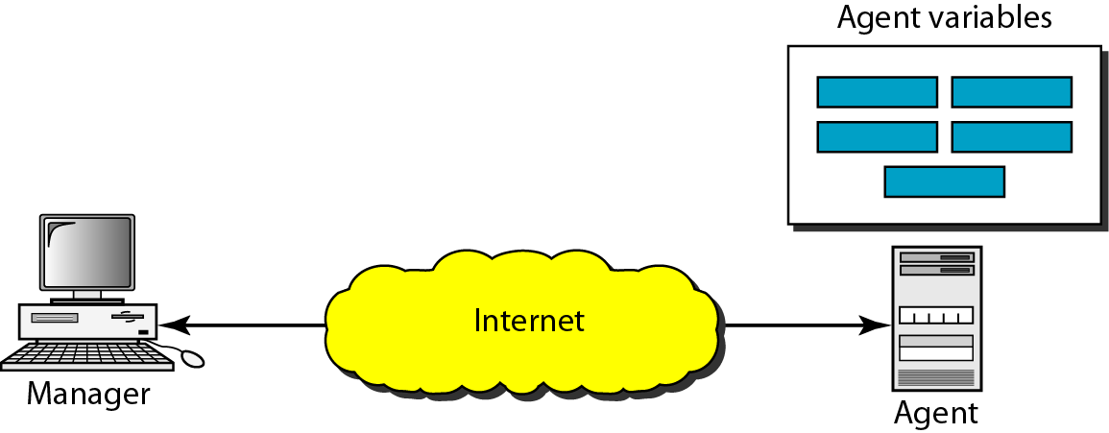
SIMPLE NETWORK MANAGEMENT PROTOCOL (SNMP)
The Simple Network Management Protocol (SNMP) is a framework for managing devices in an internet using the TCP/IP protocol suite.
It provides a set of fundamental operations for monitoring and maintaining an internet. SNMP frees management tasks from both the physical characteristics of the managed devices and the underlying networking technology.
It can be used in a heterogeneous internet made of different LANs and WANs connected by routers made by different manufacturers.
SNMP uses the concept of manager and agent. That is, a manager, usually a host controls and monitors a set of agents as shown below:
Fig. 2 SNMP Concept

Slide 6
SIMPLE NETWORK MANAGEMENT PROTOCOL (SNMP) cont..
A management station, called a manager, is a host that runs the SNMP client program. A managed station, called an agent, is a router (or a host) that runs the SNMP server program.
Management is achieved through simple interaction between a manager and an agent.
Agents can contribute to the management process. The server program running on the agent can check the environment, and if it notices something unusual, it can send a warning message, called a trap, to the manager.
In other words, management with SNMP is based on three basic ideas:
A manager checks an agent by requesting information that reflects the behavior of the agent.
A manager forces an agent to perform a task by resetting values in the agent database.
An agent contributes to the management process by warning the manager of an unusual situation.

Slide 7
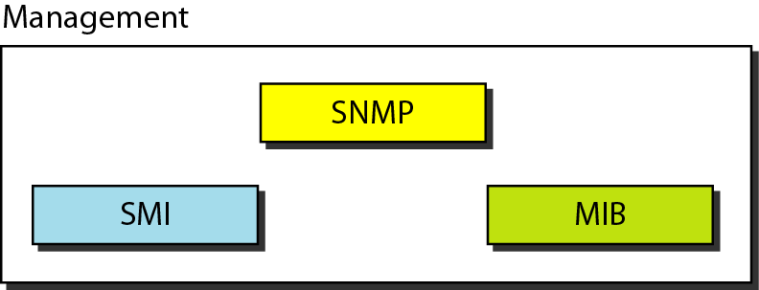
Components of Network Management on the Internet
To do management tasks, SNMP uses two other protocols: Structure of Management Information (SMI) and Management Information Base (MIB).
SNMP defines the format of packets exchanged between a manager and an agent. It reads and changes the status (values) of objects (variables) in SNMP packets.
Fig. 3 SNMP components

Slide 8
SMI
To use SNMP, we need rules. We need rules for naming objects. This is particularly important because the objects in SNMP form a hierarchical structure (an object may have a parent object and some children objects).
Part of a name can be inherited from the parent. We also need rules to define the type of the objects.
What types of objects are handled by SNMP?
Can SNMP handle simple types or structured types?
How many simple types are available?
What are the sizes of these types? What is the range of these types?
In addition, how are each of these types encoded?
SMI only defines the general rules for naming objects, defining object types (including range and length), and showing how to encode objects and values.
SMI does not define the number of objects an entity should manage or name the objects to be managed or define the association between the objects and their values.

Slide 9
MIB
For each entity to be managed, this protocol must define the number of objects, name them according to the rules defined by SMI, and associate a type to each named object. This protocol is MIB
MIB creates a collection of named objects, their types, and their relationships to each other in an entity to be managed.
Lets consider a simple scenario to understand the basic functioning of SNMP, SMI and MIB protocols. A manager station (SNMP client) wants to send a message to an agent station (SNMP server) to find the number of UDP user datagrams received by the agent
MIB is responsible for finding the object that holds the number of the UDP user datagrams received.
SMI, with the help of another embedded protocol, is responsible for encoding the name of the object.
SNMP is responsible for creating a message, called a GetRequest message, and encapsulating the encoded message.
Of course, things are more complicated than this simple overview, but we first need more details of each protocol.

Slide 10
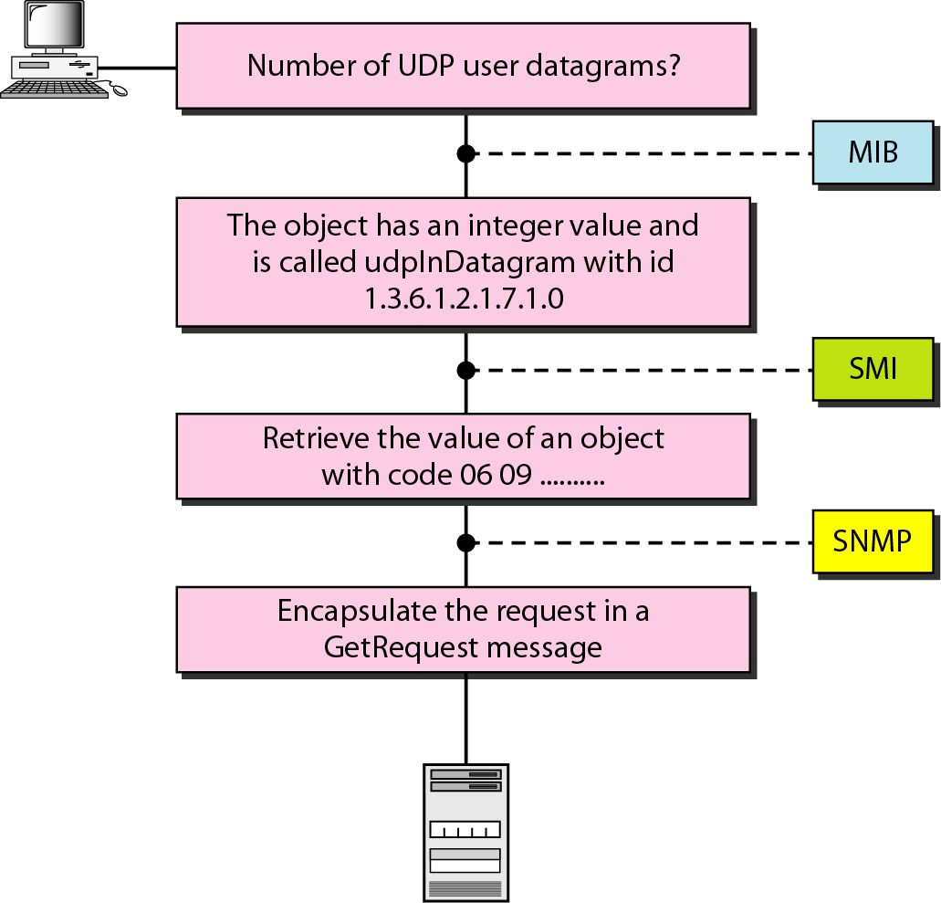
Management Overview
Fig. 4 Management Overview in SNMP

Slide 11
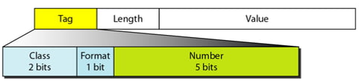
SMI Object attributes
It emphasizes three attributes to handle an object: name, data type, and encoding method
Name: I requires that each managed object (such as a router, a variable in a router, a value) have a unique name. To name objects globally, SMI uses an object identifier, which is a hierarchical identifier based on a tree structure.
Type: SMI has two broad categories of data type: simple and structured. The simple data types are atomic data types. E.g., Integer32, Unsigned32, OCTET STRING…The structured data type is a combination of simple data types
Encoding Method: SMI uses Basic Encoding Rules (BER), to encode data to be transmitted over the network. BER specifies that each piece of data be encoded in triplet format: tag, length, and value
Fig. 5 Encoding Format

Slide 12
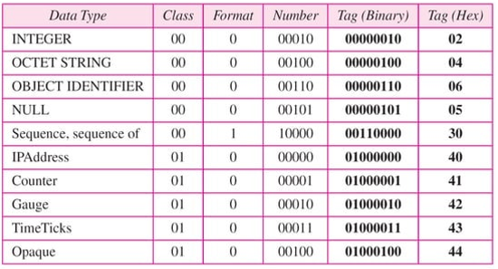
Codes for data type
The codes of data type and their corresponding tags in Binary and Hexadecimal are as follows:

Slide 13
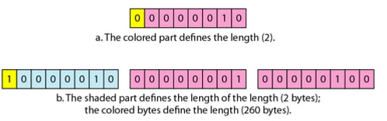
Length field of Encoding Format Header
The length field is 1 or more bytes.
If it is 1 byte, the most significant bit must be 0. The other 7 bits define the length of the data.
If it is more than 1 byte, the most significant bit of the first byte must be 1. The other 7 bits of the first byte define the number of bytes needed to define the length.
Fig. 6 Length Format

Slide 14
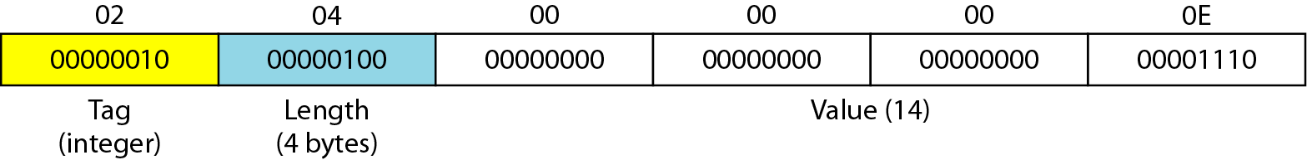
EXAMPLE 1
How to define INTEGER 14.
Fig. 7 Solution for INTEGER 14 in SNMP

Slide 15
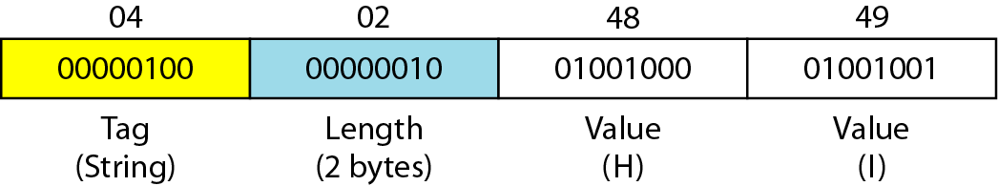
EXAMPLE 2
How to define the OCTET STRING “HI”.
Fig. 8 Solution for OCTET STRING “HI” in SNMP

Slide 16
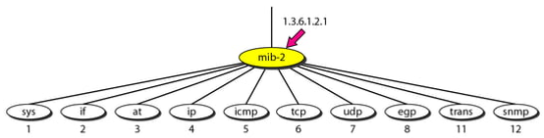
MIB version 2
Each agent has its own MIB2, which is a collection of all the objects that the manager can manage.
The objects in MIB2 are categorized under several groups: system, interface, address translation, ip, icmp, tcp, udp, egp, transmission, and snmp (note that group 9 is deprecated).
These groups are under the mib-2 object in the object identifier tree.
Each group has defined variables and/or tables.
Fig. 9 mip-2

Slide 17
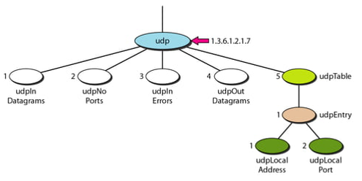

Accessing MIB variables
To show how to access different variables, we use the udp group as an example.
There are four simple variables in the udp group and one sequence of (table of) records.
To access any of the simple variables, we use the id of the group (1.3.6.1.2.1.7) followed by the id of the variable. The following shows how to access each variable.
Fig. 10 udp group

Slide 18
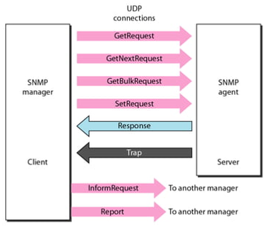
SNMP PDUs
SNMPv3 defines eight types of protocol data units (or PDUs): GetRequest, GetNext-Request, GetBulkRequest, SetRequest, Response, Trap, InformRequest, and Report
Fig. 11 SNMP PDUs

Slide 19
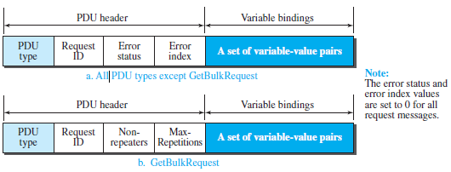
PDU Format
The format for the eight SNMP PDUs is:
Fig. 12 SNMP PDU Format

Slide 20
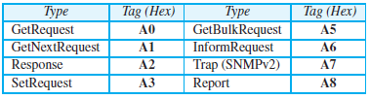
Fields of PDU
PDU type: This field defines the type of the PDU
Request ID: This field is a sequence number used by the manager in a request PDU and repeated by the agent in a response. It is used to match a request to a response.
Error status: This is an integer that is used only in response PDUs to show the types of errors reported by the agent. Its value is 0 in request PDUs.
Non-repeaters: This field is used only in a GetBulkRequest PDU. The field defines the number of non-repeating (regular objects) at the start of the variablevalue list.
Error index: The error index is an offset that tells the manager which variable caused the error.
Max-repetitions: This field is also used only in a GetBulkRequest PDU. The field defines the maximum number of iterations in the table to read all repeating objects.
Variable-value pair list: This is a set of variables with the corresponding values the manager wants to retrieve or set. The values are null in request PDUs.

Slide 21
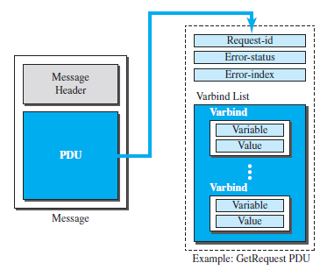
SNMP Example
The example of SNMP message:

Slide 22
Practice Questions:
To access a FTP server through your browser you need to put certain protocol directive to the browser address bar. How will you convert the following URL to a FTP address?
speedtest.tele2.net

Slide 23
Practice Questions:
If you have to design a system which can use only one communication port for data as well as control signalling for transferring the files. Can you do that? What are your options to do the same?

Slide 24
Practice Questions:
If you have design the website for a finance firm dealing with online financial transactions. Will you use HTTP for the same?

Slide 25
Practice Questions:
If a packet takes 0.296 ms to travel from client to server, what will be value for RTT in this case?

Slide 26
References
Books:
Data Communications and Networking’ by Forouzan, 5th Edition, 2013.
Computer Networks’ By Andrew S. Tanenbaum 5th Edition, Pearson Education,2013.
Data and Computer Communications’ by William Stallings, 8th Edition, Pearson,2007.
E-Resources:
CISCO Networking Academy
https://library.chitkara.edu.in/subscribed-books.php

